Slide 1
Weekly Update #25
Gijs Admiraal

Slide 2
This week?
Got absorbing state to work
Fixed issues in training/validation loop
Found new issues
Worked on all atom analysis

Slide 3
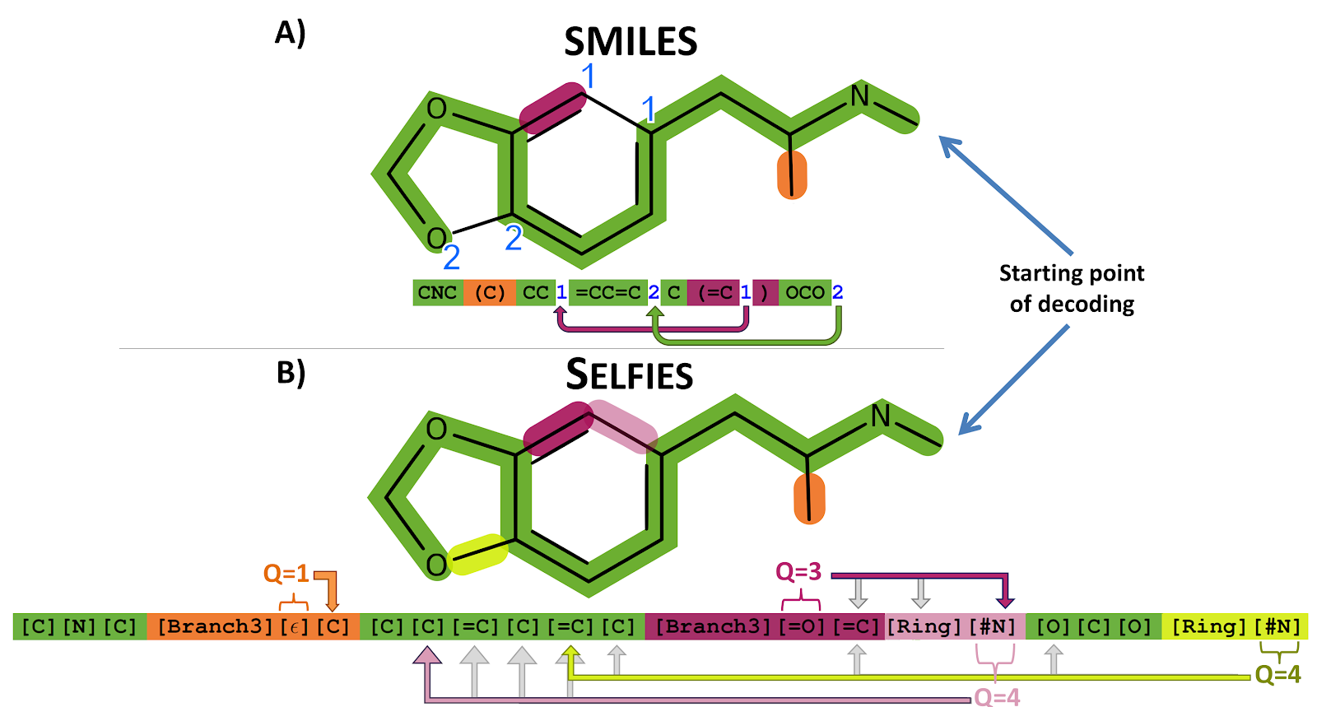
SELFIES

Slide 4
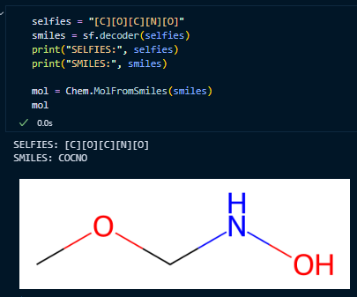
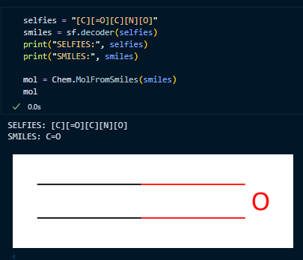
SELFIES

Slide 5
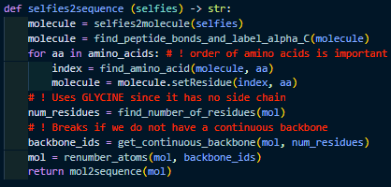
Analyse all-atom
RDKit: molecule.GetSubstructMatches(molecule_sub)
Finds substructures in a molecule
Original code:
Validate by turning aa seq into selfies seq and compare

Slide 6
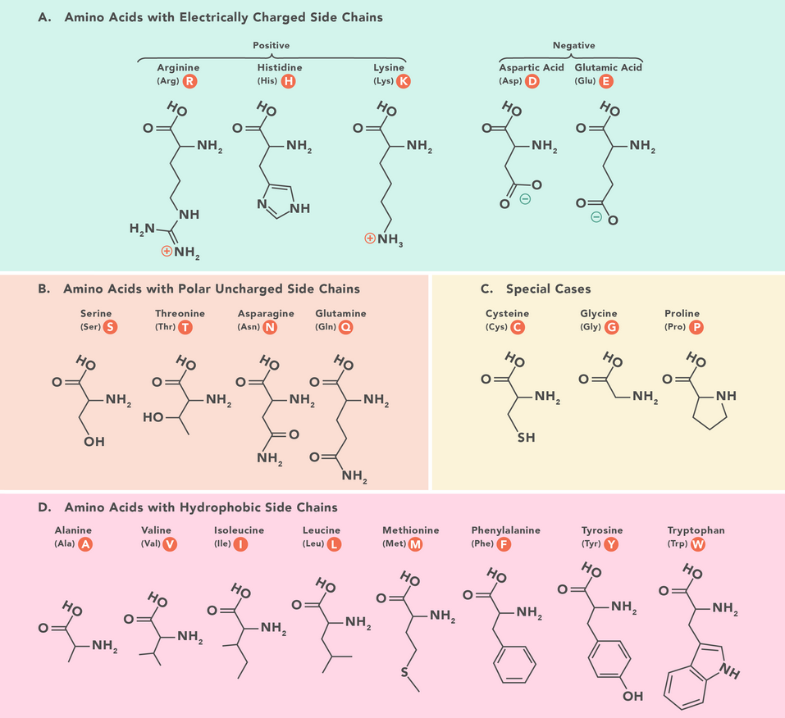

Slide 7
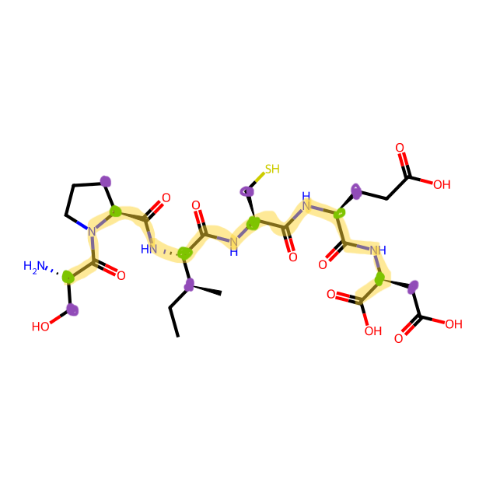
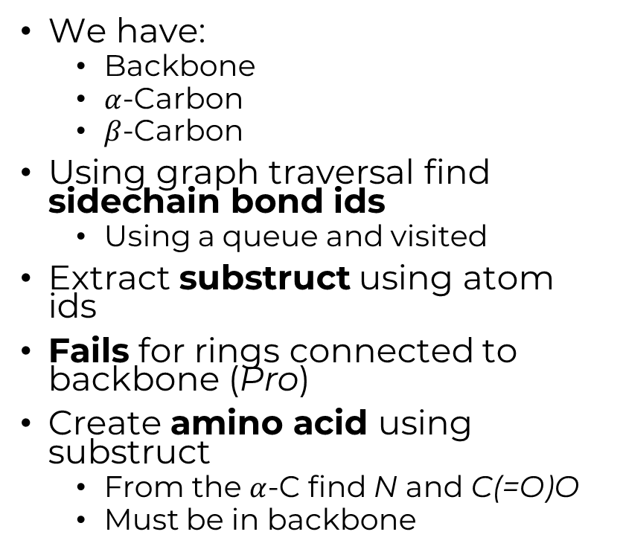
Analyse all-atom
SP
I
CED
We have:
Backbone
$α$-Carbon
$β$-Carbon
Using graph traversal find sidechain bond ids
Using a queue and visited
Extract substruct using atom ids
Fails for rings connected to backbone (Pro)
Create amino acid using substruct
From the $α$-C find N and C(=O)O
Must be in backbone

Slide 8
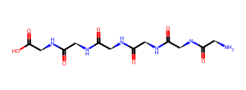
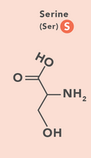
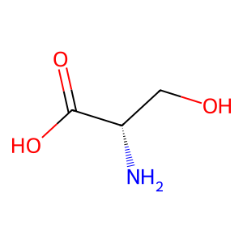
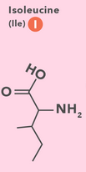
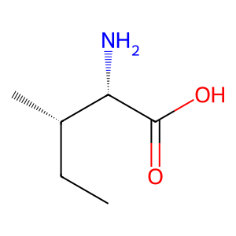
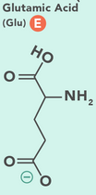
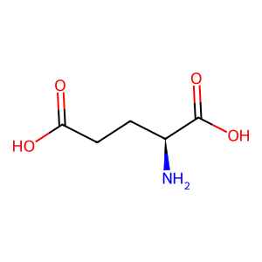
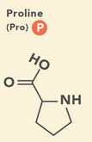
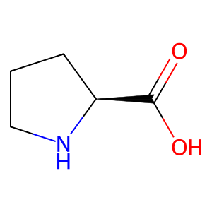
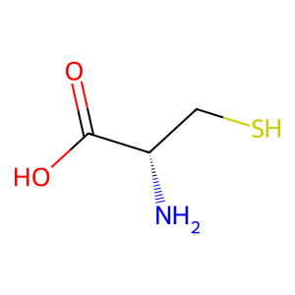
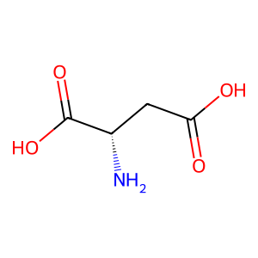
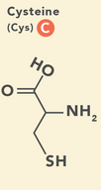

Backbone:

Slide 9
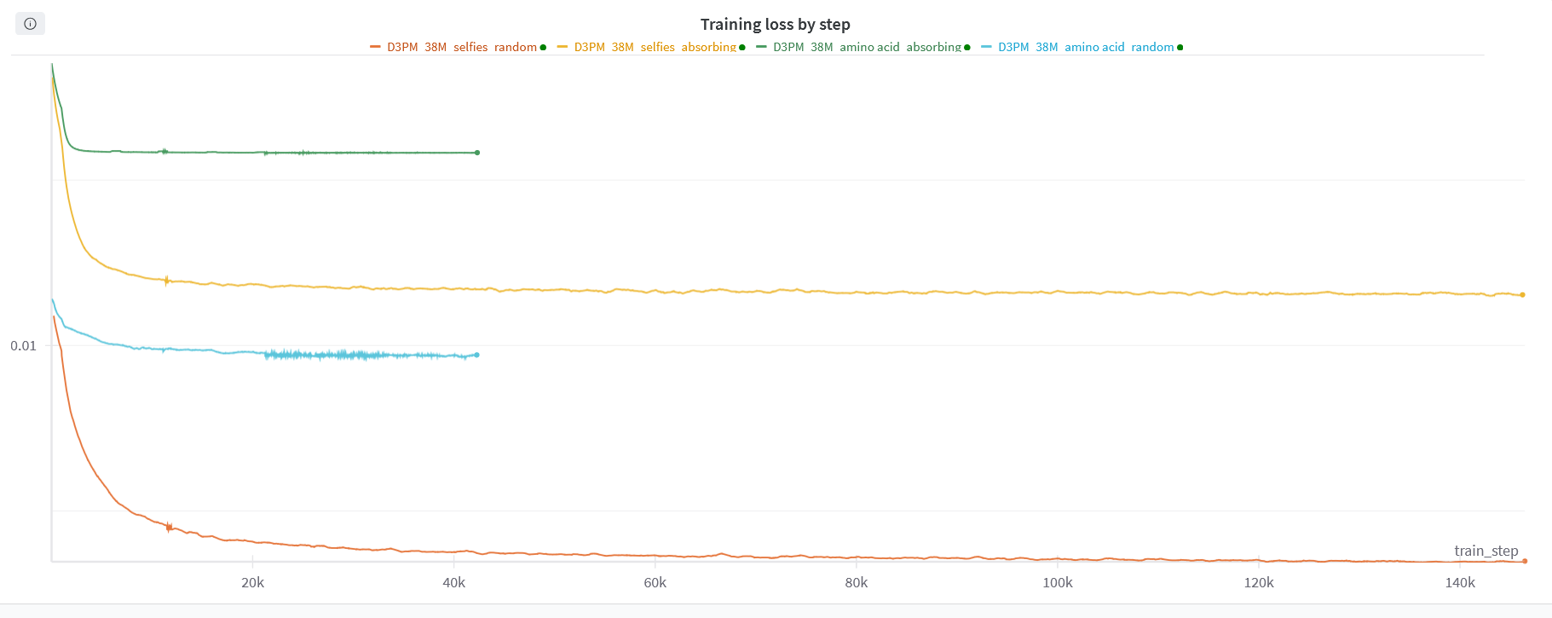
Training

Slide 10
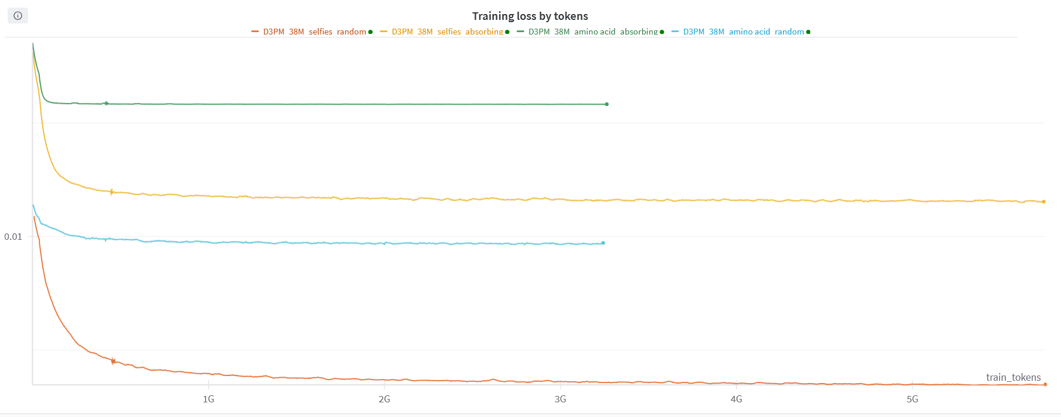
Training

Slide 11
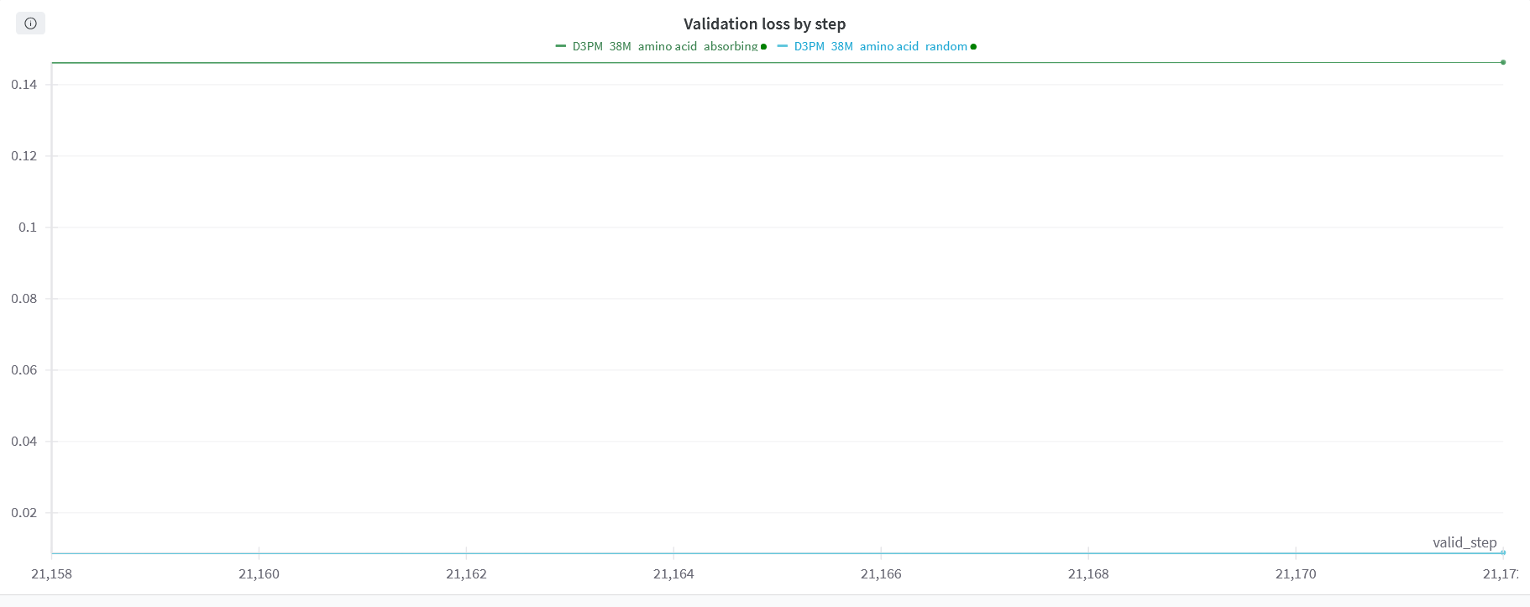
Validation

